Slide 1
Recursive functions and functional programming
Fani Apostolidou Kiouti

Slide 2
Repetitive tasks
for-loop: flow statement iterating through the elements and evaluating the command
# print every odd number in a vector for(i in 1:11) { if(!i %% 2){ # %%: modulo, the remainder of a division next } print(i) }
## [1] 1 ## [1] 3 ## [1] 5 ## [1] 7 ## [1] 9 ## [1] 11

Slide 3
apply family
R alternative: a series of iterative functions evaluating to the margins of an array
x <- c(1:11) x[lapply(x, "%%", 2) == 1]
## [1] 1 3 5 7 9 11

Slide 4
Difference
Last item reached?
Identify elements
True
False
Evaluate function
Execute statements
Exit
Return object

Slide 5
apply family
A function | looping over | and producing
apply | array | vector
lapply | list | list
sapply | list | vector;matrix;list
tapply | subsets of a vector | vector
mapply | in parallel application over a set of arguments | list

Slide 6
apply()
A base function used to run the same function over array margins
Turn a data frame into a matrix (using the as.matrix)
Syntax
apply (X, MARGIN, FUN, ...)
By default, 1 indicates rows, 2 columns and c(1,2) both.

Slide 7
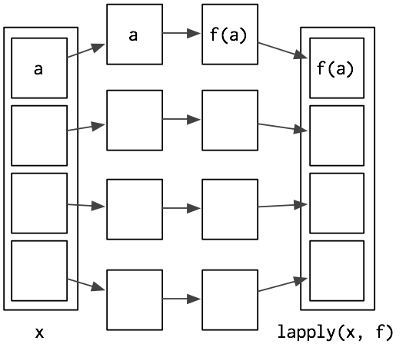
lapply()
A base function used to run the same function over lists
Returns a list of the same length as X
Syntax
lapply (X, FUN)
Anonymous functions

Slide 8
sapply()
Simplified output with regard to dimensions
Allows data frames as input
Syntax
sapply (X, FUN)
* {taRifx} wrapper for column selection: taRifx::japply()

Slide 9
sapply()
sapply is used for lists just as lapply but returns a vector back
sapply significantly expands its functionality in combination with the base function split(x, f)
split() divides the input (x) according to groups (f).

Slide 10
mapply()
a multivariate version of sapply
applies the function to multiple lists or multiple vector arguments
its first argument is the function to be evaluated
mapply can also be used to create a new variable from existing ones

Slide 11
Data aggregation
library(purrr);library(magrittr)
%>% the pipe operator - pass information (or data) from one program process to another sequentially - essentially a function - translates the readable code into a form with intermediate objects
# Display the first 6 rows df %>% head()
## V1 V2 ## 1 2.348777 5.855726 ## 2 2.323559 5.775086 ## 3 2.717057 5.257197 ## 4 2.015672 5.954630 ## 5 2.721091 5.568483 ## 6 2.259794 5.120632

Slide 12
Data aggregation
Pipes are very convenient, but there are a few limitations in their use:
Multidirectional relationships cannot be piped
A pipe can only transfer one object at a time
Lazy evaluation is unstable with pipes
They use a temporary environment

Slide 13
Data aggregation
{purrr} offers a variety of functions, similar to the apply family:
The * corresponds to the returned value structure and stands for: - dbl double - int integer - chr character - lgl logical - dfc dataframe (from cbind) - dfr dataframe (from rbind)
function | objects
map_* | list or vector
map2_* | pairs of elements from two lists or vectors
pmap_* | groups of elements from a list of lists or vectors
imap_* | apply a function to each element and its index

Slide 14
Data aggregation
# Using a pipe and a map function to derive means for all variables in df df %>% map_dbl(mean)
## V1 V2 ## 2.496207 5.522392
# Using only the map function for the standard deviations map_dbl(df, sd)
## V1 V2 ## 0.2886109 0.3019704

Slide 15
{dplyr}
verb | function
mutate(.data, var = …) | add new variables computed from existing variables
select(.data, columns) | pick variables based on their names or logical conditions
filter(.data, rows) | pick cases based on their values or logical conditions
summarise(.data, metrics) | reduce multiple values down to a single summary
arrange(.data, condition) | change the ordering of the rows
group_by(.data, variable) | group by a vector
across(.data, vector, function) | apply a function across a selection of columns

Slide 16
{tidyr}
ID | v1 | v2
P1
p2
ID | KEY | Values
P1 | V1
P2 | V1
P1 | V2
P2 | V2
gather(data, key = "key", value = "value“)
spread(data, key, value)
Names of new key and value columns, as strings or symbols.

Slide 17
R session
simulations and applications

Slide 18
apply()
# Create a two dimensional matrix to work with: ## matrix(data, nrow, ncol, byrow = FALSE, dimnames = NULL) M <- matrix(seq(1,12), 3, 4) M
## [,1] [,2] [,3] [,4] ## [1,] 1 4 7 10 ## [2,] 2 5 8 11 ## [3,] 3 6 9 12
# apply FUN=min to rows to find the minimum value in each apply(M, 1, min)
## [1] 1 2 3
# or max to columns to find the maximum value apply(M, 2, max)
## [1] 3 6 9 12

Slide 19
apply()
Arrays with higher dimensions can be handled with apply as well, however indexing is more complicated:
# Build a 3-dimensional array A <- array(seq(24), dim = c(3,4,2)) A
## , , 1 ## ## [,1] [,2] [,3] [,4] ## [1,] 1 4 7 10 ## [2,] 2 5 8 11 ## [3,] 3 6 9 12 ## ## , , 2 ## ## [,1] [,2] [,3] [,4] ## [1,] 13 16 19 22 ## [2,] 14 17 20 23 ## [3,] 15 18 21 24
# Apply sum across each A[*, *, ] - In this case the result will be two-dimensional apply(A, c(1,2), sum) #sum across 3rd dimension
## [,1] [,2] [,3] [,4] ## [1,] 14 20 26 32 ## [2,] 16 22 28 34 ## [3,] 18 24 30 36

Slide 20
lapply()
lapply is used to apply a function to each element of a list in turn and get a list as a returned value.
# Create a list, L L <- list(d = 8, m = c(T,F,T), y = 1:13) L
## $d ## [1] 8 ## ## $m ## [1] TRUE FALSE TRUE ## ## $y ## [1] 1 2 3 4 5 6 7 8 9 10 11 12 13
# Apply the length function on L's elements to see the number of values in each lapply(L, FUN = length)
## $d ## [1] 1 ## ## $m ## [1] 3 ## ## $y ## [1] 13

Slide 21
lapply()
lapply() will pass the elements from the list as the first argument to the function
lapply(1:3, runif, min = 6, max = 7)
## [[1]] ## [1] 6.63747 ## ## [[2]] ## [1] 6.394916 6.498313 ## ## [[3]] ## [1] 6.099452 6.969033 6.257661
# runif(n, min, max) generates n random # deviates from the uniform distribution on the interval(min, max).

Slide 22
lapply()
Anonymous functions, within lapply()
# calculate the coefficient of variation in the columns of a random dataframe, df: # a random dataframe using, again, the uniform distribution df <- as.data.frame(cbind(runif(100, 2,3), runif(100, 5,6))) # CV equals the standard deviation divided by the mean lapply(df, function(x) x = sd(x)/mean(x))
## $V1 ## [1] 0.1156198 ## ## $V2 ## [1] 0.05468109

Slide 23
sapply()
V <- c(o = 1, e = 6, o = 3, e = 12, o = 5) split(V, names(V))
## $e ## e e ## 6 12 ## $o ## o o o ## 1 3 5
# Split according to another grouping factor, defined separately m3 <- c("Non3", "M3", "M3", "M3", "Non3") split(V, m3)
## $M3 ## e o e ## 6 3 12 ## $Non3 ## o o ## 1 5
# Combine the two grouping variables in a single interaction split(V, list(names(V), m3))
## $e.M3 ## e e ## 6 12
## ## $o.M3 ## o ## 3
## ## $e.Non3
## named numeric(0) ##
## $o.Non3 ## o o ## 1 5
split(V, list(names(V), m3), drop = T)
## $e.M3 ## e e ## 6 12
## ## $o.M3 ## o ## 3
## ## $o.Non3 ## o o ## 1 5
# Using a split function to calculate the means in each subset of interactions in V sapply(split(V, list(names(V), m3)), mean)
## e.M3 o.M3 e.Non3 o.Non3 ## 9 3 NaN 3

Slide 24
mapply()
mapply(mean, L)
## d m y ## 8.0000000 0.6666667 7.0000000
mapply(matrix, list(x = runif(12, 3, 5), y = 1:6, z = 1), nrow = c(3, 2, 1))
## $x ## [,1] [,2] [,3] [,4] ## [1,] 4.961021 3.165185 4.597773 4.679408 ## [2,] 4.513986 4.827525 4.686649 4.538507 ## [3,] 3.539403 4.422921 3.658304 3.647082 ## ## $y ## [,1] [,2] [,3] ## [1,] 1 3 5 ## [2,] 2 4 6 ## ## $z ## [,1] ## [1,] 1

Slide 25
Data aggregation; implementation
What if we had a more complex dataset, for which we want to inspect elements, derive some measures, inspect plots and calculate a new variable?
# Impute numeric values from the normal distribution: # First, define means (we aim for 3 num variables, therefore three means) mu <- list(50, 1300, 36)
# Define their standard deviations sigma <- list(5, 250, 2)
# Combine them into one list (20 corresponds to the number of observations - it is arbitrary) nums <- list(20, mu, sigma)

Slide 26
Data aggregation; implementation
library(dplyr)
# Now, use pmap_dfc to iterate through the values of the num list and calculate random values from the normal distribution nums %<>% pmap_dfc(rnorm)
## New names: ## * NA -> ...1 ## * NA -> ...2 ## * NA -> ...3
# Name the newly born variables names(nums) <- c("age", "brthw", "brtha")
# Create a data frame with the numericals, and ID variable and an arbitrary gender variable dtfr <- data.frame(id = c(1:20), gender = rep(c("m","f"), 10), nums ) dtfr$gender <- as.factor(dtfr$gender)
## Reasonably, one would like to calculate metrics for the whole dataset map_dbl(dtfr, mean)
## id gender age brthw brtha ## 10.50000 NA 50.10937 1303.15047 35.58694

Slide 27
Data aggregation; implementation
# and then look for correlations among variables - in this case, birth weight by birth age in the gender categories. dtfr %>% split(.$gender) %>% map(~lm(brthw ~ brtha, data = .))
## $f ## Call: ## lm(formula = brthw ~ brtha, data = .) ## ## Coefficients: ## (Intercept) brtha ## 2215.38 -25.35 ## $m ## Call: ## lm(formula = brthw ~ brtha, data = .) ## ## Coefficients: ## (Intercept) brtha ## 1284.2610 0.1947

Slide 28
Data aggregation; implementation
# One may wish to call for another calculated value from the lm formula, in this example we call for the R-squared for each model.
dtfr %>% split(.$gender) %>% map(~lm(brthw ~ brtha, data = .)) %>% map(summary) %>% map_dbl(~.$r.squared)
## f m ## 9.936762e-02 1.746506e-05

Slide 29
Data aggregation; implementation
# Creating multiple plots
## First, choose the variable names from the dataset, to inform the map() on what to iterate. rspn for the response variable, expl for the explanatory variables rspn <- names(dtfr)[4] expl <- names(dtfr)[c(2,3,5)]
# Then define a plotting function library(ggplot2) scat.fn = function(x, y) { ggplot(dtfr, aes(x = .data[[x]], y = .data[[y]]) ) + geom_point() + geom_smooth(method = "loess") }
# Now use map, to iterate over expl elements and evaluate the function scatter_fun map(expl, ~scat.fn(.x, "brthw") )

Slide 30
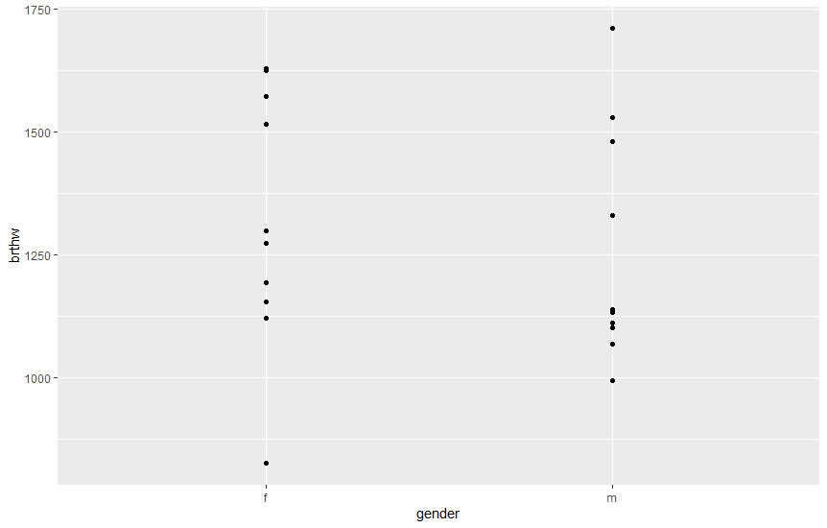

Slide 31
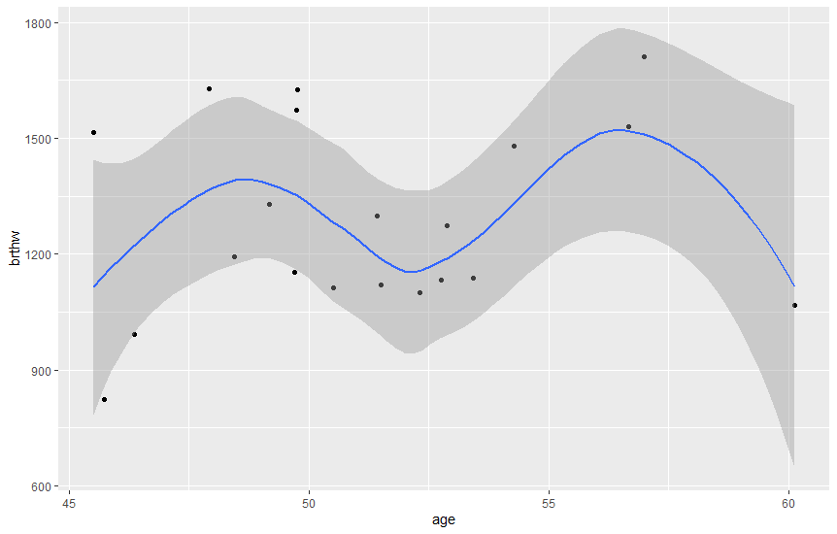

Slide 32
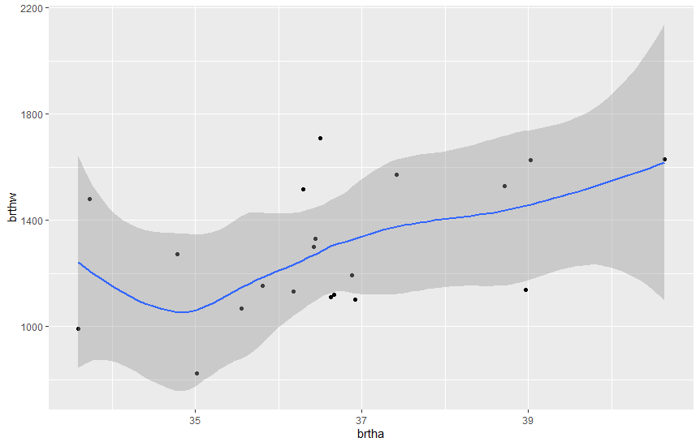

Slide 33
Import a database
glimpse(irs)
## Rows: 52 ## Columns: 6 ## $ ID <dbl> 1, 2, 3, 4, 5, 6, 7, 8, 9, 10, 11, 12, 13, 14, 15, ~ ## $ systolic.pressure <dbl> 144.5, 143.3, 150.1, 141.1, 144.0, 137.6, 142.1, 14~ ## $ diastolic.pressure <dbl> 72.0, 78.2, 73.9, 61.7, 61.4, 73.4, 79.2, 66.6, 82.~ ## $ sodium.excretion <dbl> 149.3, 133.0, 142.6, 5.8, 0.2, 148.9, 184.3, 194.1,~ ## $ country <chr> "Argentina", "Belgium", "Belgium", "Brazil", "Brazi~ ## $ gender <chr> "M", "M", "M", "F", "F", "F", "M", "F", "F", "F", "~
# drop the ID variable to facilitate computations irsrd <- select(irs, -ID) glimpse(irsrd)
## Rows: 52 ## Columns: 5 ## $ systolic.pressure <dbl> 144.5, 143.3, 150.1, 141.1, 144.0, 137.6, 142.1, 14~ ## $ diastolic.pressure <dbl> 72.0, 78.2, 73.9, 61.7, 61.4, 73.4, 79.2, 66.6, 82.~ ## $ sodium.excretion <dbl> 149.3, 133.0, 142.6, 5.8, 0.2, 148.9, 184.3, 194.1,~ ## $ country <chr> "Argentina", "Belgium", "Belgium", "Brazil", "Brazi~ ## $ gender <chr> "M", "M", "M", "F", "F", "F", "M", "F", "F", "F", "~

Slide 34
Practice on a database
Let us compute the mean arterial pressure and add it as a new variable in the dataset:
# use the assignment pipe operator %<>% irsrd %<>% mutate(map = (systolic.pressure/3 + diastolic.pressure)) glimpse(irsrd)
## Rows: 52 ## Columns: 6 ## $ systolic.pressure <dbl> 144.5, 143.3, 150.1, 141.1, 144.0, 137.6, 142.1, 14~ ## $ diastolic.pressure <dbl> 72.0, 78.2, 73.9, 61.7, 61.4, 73.4, 79.2, 66.6, 82.~ ## $ sodium.excretion <dbl> 149.3, 133.0, 142.6, 5.8, 0.2, 148.9, 184.3, 194.1,~ ## $ country <chr> "Argentina", "Belgium", "Belgium", "Brazil", "Brazi~ ## $ gender <chr> "M", "M", "M", "F", "F", "F", "M", "F", "F", "F", "~ ## $ map <dbl> 120.1667, 125.9667, 123.9333, 108.7333, 109.4000, 1~

Slide 35
Selecting rows and columns with criteria or by position:
Select rows with logical criteria
filter(irsrd, sodium.excretion > 150)
## # A tibble: 27 x 6 ## systolic.pressure diastolic.pressure sodium.excretion country gender map ## <dbl> <dbl> <dbl> <chr> <chr> <dbl> ## 1 142. 79.2 184. Canada M 127. ## 2 145. 66.6 194. Colombia F 115. ## 3 145. 77.5 164. Finland F 126. ## 4 146 79.2 190. Hungary F 128. ## 5 134. 70.7 194. India M 115. ## 6 144. 73.9 153. India M 122. ## 7 149. 79.6 176. Italy F 129. ## 8 149. 69.9 170. Italy F 120. ## 9 140. 76 170 Italy F 123. ## 10 134. 72.9 163. Italy F 118. ## # ... with 17 more rows

Slide 36
Selecting rows and columns with criteria or by position:
Remove duplicates
distinct(irsrd)
## # A tibble: 52 x 6 ## systolic.pressure diastolic.pressure sodium.excretion country gender map ## <dbl> <dbl> <dbl> <chr> <chr> <dbl> ## 1 144. 72 149. Argentina M 120. ## 2 143. 78.2 133 Belgium M 126. ## 3 150. 73.9 143. Belgium M 124. ## 4 141. 61.7 5.8 Brazil F 109. ## 5 144 61.4 0.2 Brazil F 109. ## 6 138. 73.4 149. Canada F 119. ## 7 142. 79.2 184. Canada M 127. ## 8 145. 66.6 194. Colombia F 115. ## 9 136. 82.1 136. Denmark F 127. ## 10 137. 75 139. Germany F 121. ## # ... with 42 more rows

Slide 37
Selecting rows and columns with criteria or by position:
Select rows by position
slice(irsrd, 21:35)
## # A tibble: 15 x 6 ## systolic.pressure diastolic.pressu~ sodium.excretion country gender map ## <dbl> <dbl> <dbl> <chr> <chr> <dbl> ## 1 144. 68.4 167. Japan M 116. ## 2 137. 67.2 171. Japan M 113. ## 3 157. 73.5 201. Japan M 126. ## 4 140. 67.9 51.3 Kenya F 115. ## 5 145. 77.2 166. Malta M 125. ## 6 149 72.6 135. Mexico M 122. ## 7 148. 79.7 146. Netherlands M 129. ## 8 160. 62.9 26.8 Papua New ~ F 116. ## 9 146. 66.1 196. China M 115. ## 10 159. 67.4 158. China M 120. ## 11 141. 70.2 242. China F 117. ## 12 147. 75.7 192. Poland M 125. ## 13 147 77.9 175. Poland M 127. ## 14 132. 78.2 175. Portugal F 122. ## 15 158. 71.4 201. South Korea M 124.

Slide 38
Selecting rows and columns with criteria or by position:
Select columns whose name contains a character string
select(irsrd, contains("s"))
## # A tibble: 52 x 3 ## systolic.pressure diastolic.pressure sodium.excretion ## <dbl> <dbl> <dbl> ## 1 144. 72 149. ## 2 143. 78.2 133 ## 3 150. 73.9 143. ## 4 141. 61.7 5.8 ## 5 144 61.4 0.2 ## 6 138. 73.4 149. ## 7 142. 79.2 184. ## 8 145. 66.6 194. ## 9 136. 82.1 136. ## 10 137. 75 139. ## # ... with 42 more rows

Slide 39
Selecting rows and columns with criteria or by position:
Select columns whose name starts or ends with a character string
select(irsrd, starts_with("s"))
## # A tibble: 52 x 2 ## systolic.pressure sodium.excretion ## <dbl> <dbl> ## 1 144. 149. ## 2 143. 133 ## 3 150. 143. ## 4 141. 5.8 ## 5 144 0.2 ## 6 138. 149. ## 7 142. 184. ## 8 145. 194. ## 9 136. 136. ## 10 137. 139. ## # ... with 42 more rows
select(irsrd, ends_with("re"))
## # A tibble: 52 x 2 ## systolic.pressure diastolic.pressure ## <dbl> <dbl> ## 1 144. 72 ## 2 143. 78.2 ## 3 150. 73.9 ## 4 141. 61.7 ## 5 144 61.4 ## 6 138. 73.4 ## 7 142. 79.2 ## 8 145. 66.6 ## 9 136. 82.1 ## 10 137. 75 ## # ... with 42 more rows

Slide 40
Selecting rows and columns with criteria or by position:
Select all columns between sodium.excretion and map (inclusive)
select(irsrd, sodium.excretion:map)
## # A tibble: 52 x 4 ## sodium.excretion country gender map ## <dbl> <chr> <chr> <dbl> ## 1 149. Argentina M 120. ## 2 133 Belgium M 126. ## 3 143. Belgium M 124. ## 4 5.8 Brazil F 109. ## 5 0.2 Brazil F 109. ## 6 149. Canada F 119. ## 7 184. Canada M 127. ## 8 194. Colombia F 115. ## 9 136. Denmark F 127. ## 10 139. Germany F 121. ## # ... with 42 more rows

Slide 41
Selecting rows and columns with criteria or by position:
Arrange in different orders
irsrd %>% arrange(desc(gender)) %>% arrange(country)
## # A tibble: 52 x 6 ## systolic.pressure diastolic.pressure sodium.excretion country gender map ## <dbl> <dbl> <dbl> <chr> <chr> <dbl> ## 1 144. 72 149. Argentina M 120. ## 2 143. 78.2 133 Belgium M 126. ## 3 150. 73.9 143. Belgium M 124. ## 4 141. 61.7 5.8 Brazil F 109. ## 5 144 61.4 0.2 Brazil F 109. ## 6 142. 79.2 184. Canada M 127. ## 7 138. 73.4 149. Canada F 119. ## 8 146. 66.1 196. China M 115. ## 9 159. 67.4 158. China M 120. ## 10 141. 70.2 242. China F 117. ## # ... with 42 more rows

Slide 42
Selecting rows and columns with criteria or by position:
Arrange in different orders
#arrange(country) implies ascending order; descending must be specified irsrd %>% arrange(gender) %>% select(systolic.pressure, map, country)
## # A tibble: 52 x 3 ## systolic.pressure map country ## <dbl> <dbl> <chr> ## 1 141. 109. Brazil ## 2 144 109. Brazil ## 3 138. 119. Canada ## 4 145. 115. Colombia ## 5 136. 127. Denmark ## 6 137. 121. Germany ## 7 145. 126. Finland ## 8 146 128. Hungary ## 9 149. 129. Italy ## 10 149. 120. Italy ## # ... with 42 more rows

Slide 43
Computations with criteria:
library(countrycode)
cont <- data.frame(country = irsrd$country) cont$continent <- countrycode(sourcevar = cont[, "country"], origin = "country.name", destination = "continent")
irsrd %>% group_by(cont$continent) %>% # note that we are working in a different # environment now, the pipe will not work unless # we define the destination of the continent variable select(contains("p")) %>% summarise(mean(map))
## Adding missing grouping variables: `cont$continent`
## # A tibble: 5 x 2 ## `cont$continent` `mean(map)` ## <chr> <dbl> ## 1 Africa 119. ## 2 Americas 121. ## 3 Asia 120. ## 4 Europe 123. ## 5 Oceania 116.

Slide 44
Computations with criteria:
# how about calculating all means?
irsrd %>% group_by(cont$continent) %>% select(contains("p")) %>% map_dbl(mean)
## Adding missing grouping variables: `cont$continent`
## Warning in mean.default(.x[[i]], ...): argument is not numeric or logical: ## returning NA
## cont$continent systolic.pressure diastolic.pressure map ## NA 145.78654 73.15192 121.74744

Slide 45
Interchanging formats
irsrd %<>% tidyr::gather(key = "sample", value = "pressures", systolic.pressure, diastolic.pressure)
glimpse(irsrd)
## Rows: 104 ## Columns: 6 ## $ sodium.excretion <dbl> 149.3, 133.0, 142.6, 5.8, 0.2, 148.9, 184.3, 194.1, 1~ ## $ country <chr> "Argentina", "Belgium", "Belgium", "Brazil", "Brazil"~ ## $ gender <chr> "M", "M", "M", "F", "F", "F", "M", "F", "F", "F", "F"~ ## $ map <dbl> 120.1667, 125.9667, 123.9333, 108.7333, 109.4000, 119~ ## $ sample <chr> "systolic.pressure", "systolic.pressure", "systolic.p~ ## $ pressures <dbl> 144.5, 143.3, 150.1, 141.1, 144.0, 137.6, 142.1, 144.~
nrow(irsrd)
## [1] 104

Slide 46
Interchanging formats
To invert this function, use spread().
tidyr::spread(irsrd, key = sample, value = pressures) # no characters this time
## # A tibble: 52 x 6 ## sodium.excretion country gender map diastolic.press~ systolic.pressu~ ## <dbl> <chr> <chr> <dbl> <dbl> <dbl> ## 1 0.2 Brazil F 109. 61.4 144 ## 2 5.8 Brazil F 109. 61.7 141. ## 3 26.8 Papua New Guinea F 116. 62.9 160. ## 4 51.3 Kenya F 115. 67.9 140. ## 5 95.9 USA M 133. 78.5 163. ## 6 108. Trinidad F 127. 75.5 156. ## 7 126. USA F 119. 72.4 140. ## 8 130. Zimbabwe M 124. 75.6 145. ## 9 130. USA F 124 73.2 152. ## 10 133 Belgium M 126. 78.2 143. ## # ... with 42 more rows

